Slide 1





Employee Data Analysis Internship Project
Data Analyst : Nilesh Thorat

Slide 2
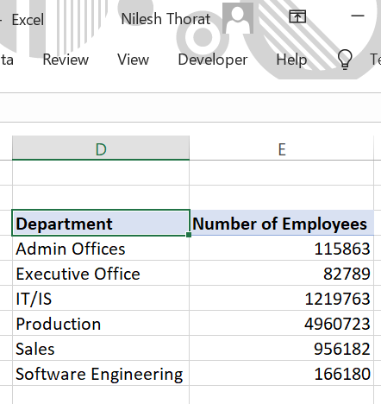
Task-1: Can you create a pivot table to summarize the total number of employees in each department?
Please find the below Screenshot of Employees count by department

Slide 3
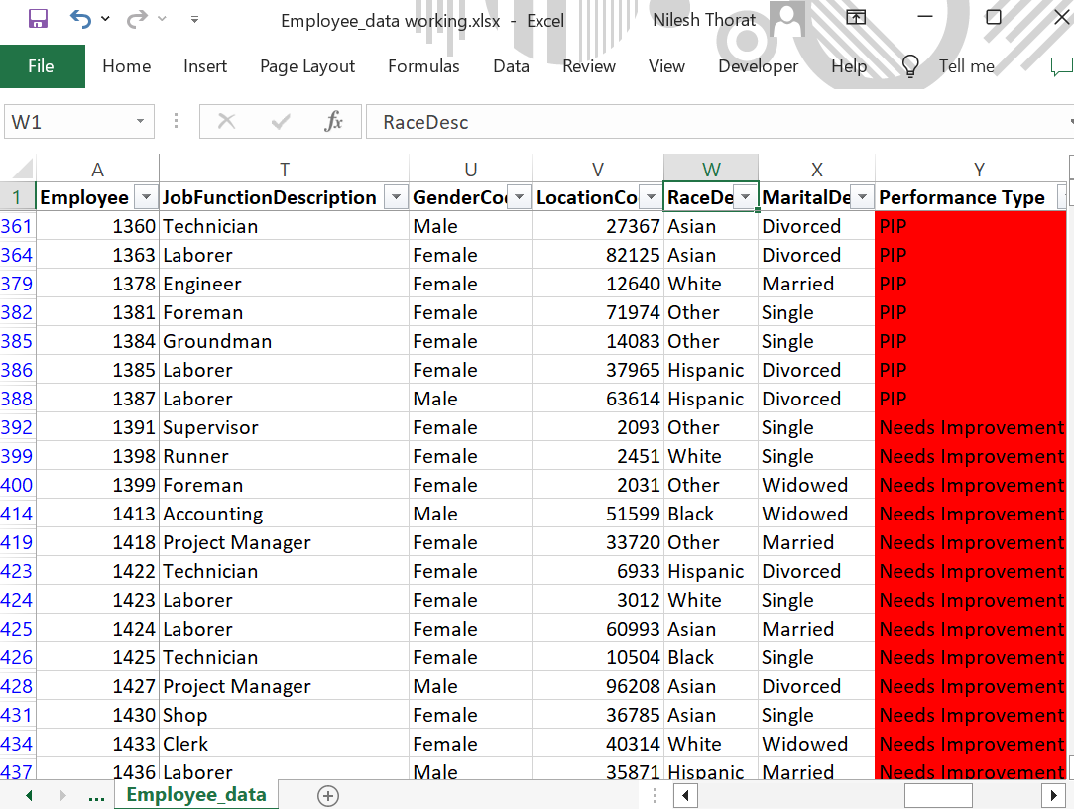
Task-2: Apply conditional formatting to highlight employees with a "Performance Score" below 3 in red
Please find the below Screenshot of conditional formatting

Slide 4
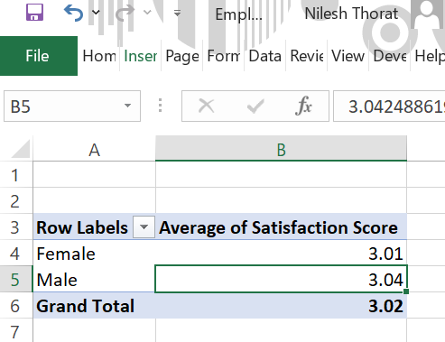
Task-3: Calculate the average "Satisfaction Score" for male and female employees separately using a pivot table
Please find the below Screenshot of Satisfaction Score by Gender

Slide 5
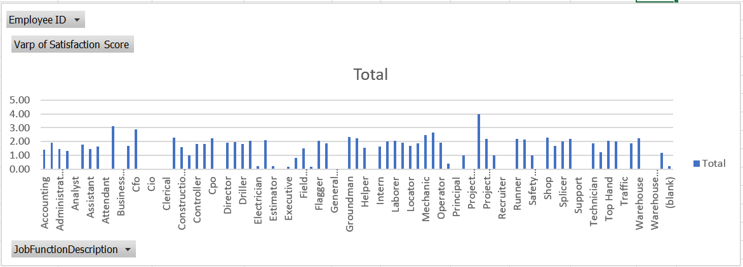
Task-4: Create a chart to visualize the distribution of "Work-Life Balance Score" for different job functions.
Please find the below Screenshot of WLB Score by Job Functions

Slide 6
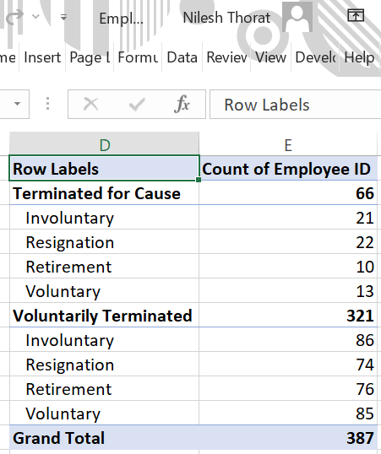
Task-5: Filter the data to display only terminated employees and find out the most common "Termination Type."
Please find the below Screenshot of Employees Termination Type

Slide 7
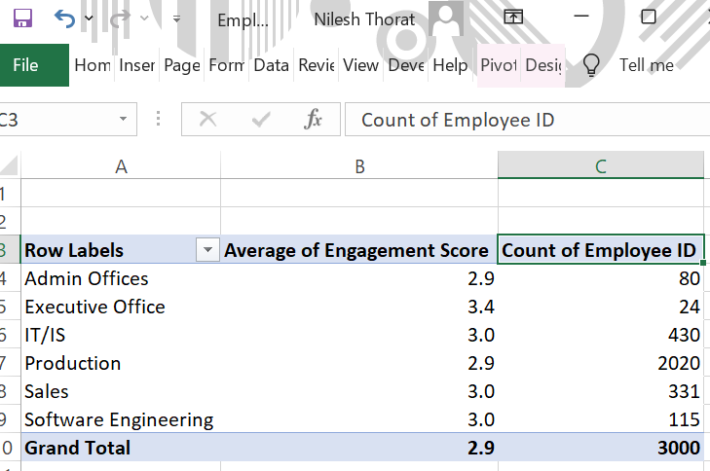
Task-6: Calculate the average "Engagement Score" for each department using a pivot table
Please find the below Screenshot of AVG Engagement Score by department

Slide 8
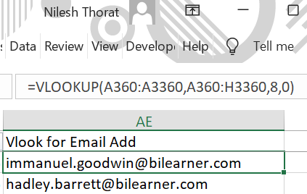
Task-7: Use VLOOKUP to find the supervisor's email address for a specific employee
Note: Data Set does not have any value column reference of Supervisor’s email address for fetching using VLOOKUP
However below is the screenshot of VLOOKUP used for finding email address of a specific employee

Slide 9
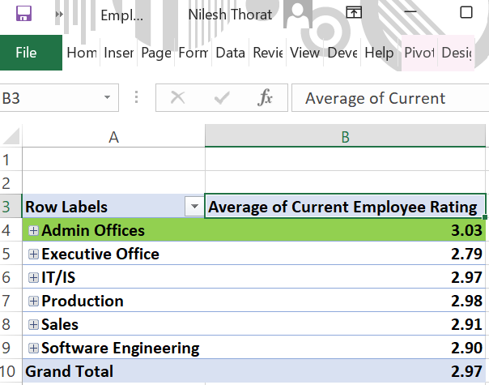
Task-8: Can you identify the department with the highest average "Employee Rating?"
Please find the below Screenshot of Highest Employee Rating

Slide 10
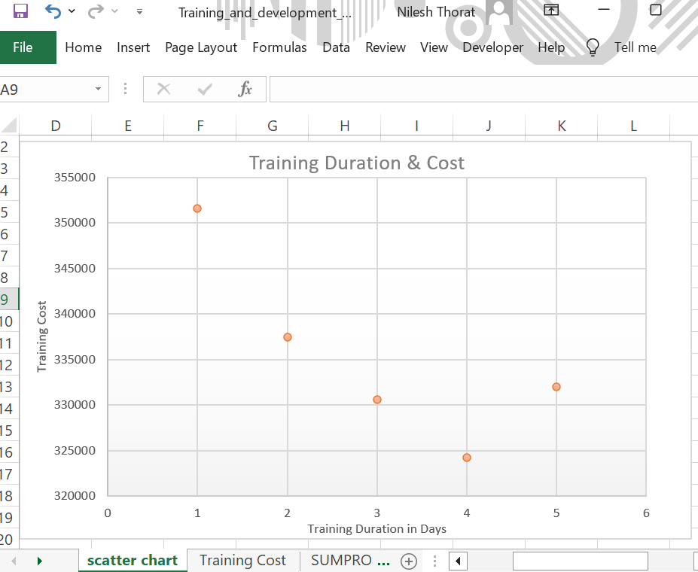
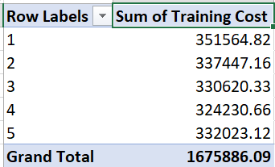
Task-9: Create a scatter plot to explore the relationship between "Training Duration (Days)" and "Training Cost."
Please find the below Screenshot of Training Cost

Slide 11
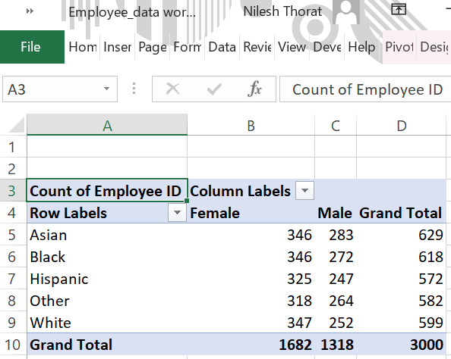
Task-10: Build a pivot table that shows the count of employees by "RaceDesc" and "GenderCode."
Please find the below Screenshot of RaceDesc by Gender

Slide 12
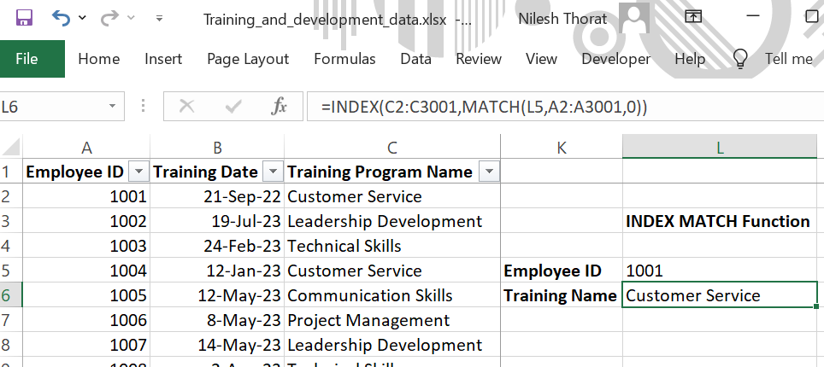
Task-11: Use INDEX and MATCH functions to find the "Training Program Name" for an employee with a specific ID
Please find the below Screenshot of INDEX MATCH Function applied

Slide 13
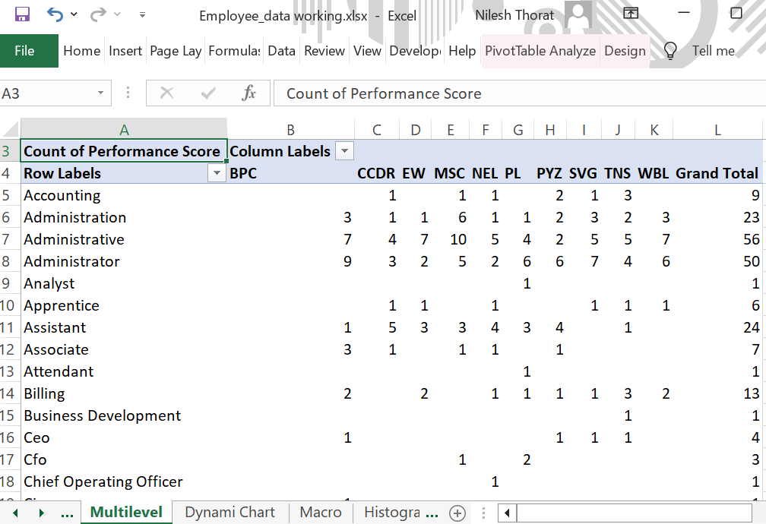
Task-12: Create a multi-level pivot table to analyze the "Performance Score" by "BusinessUnit" and "JobFunctionDescription."
Please find the below Screenshot of Multilevel Performance score

Slide 14
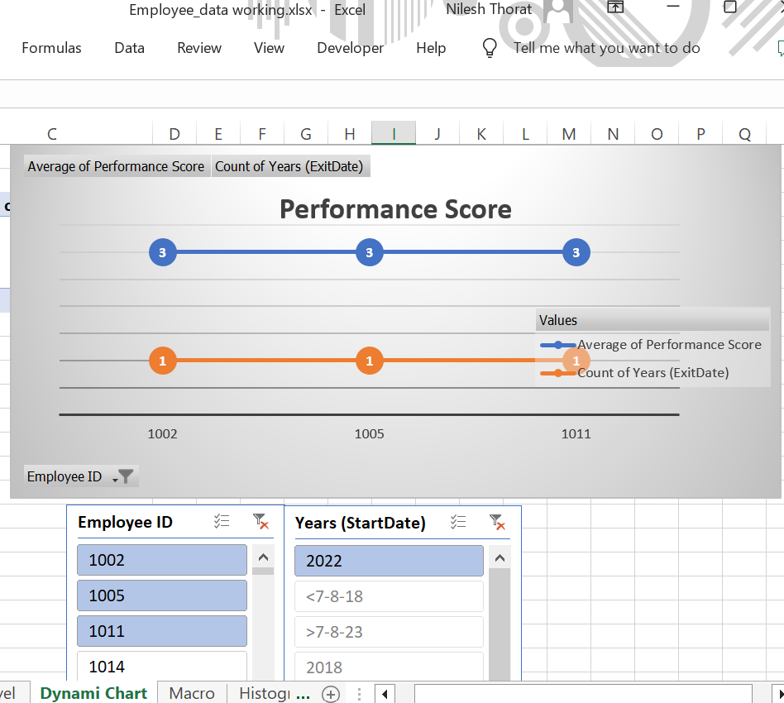
Task-13: Design a dynamic chart that allows users to select and visualize the performance of any employee over time
Note: Please note, in the data set there was no specific value column reference of Timeline of years to calculate the performances score over the time more than a year except the year of Startdate. Please find the below Screenshot of Performance score of each employee of start year

Slide 15
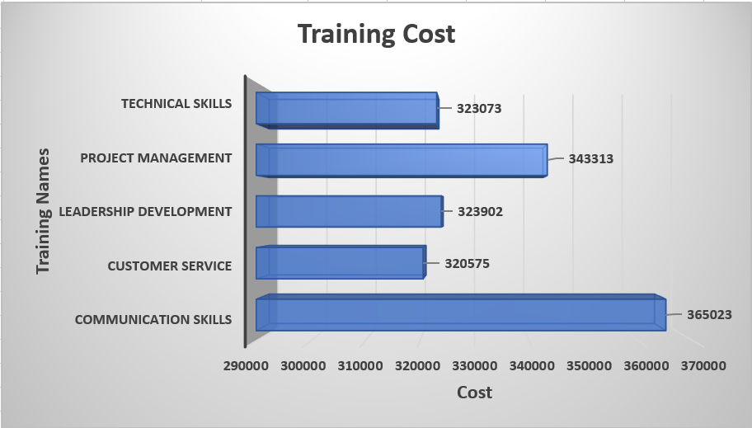
Task-14: Calculate the total training cost for each "Training Program Name" and display it in a bar chart
Please find the below Screenshot of Training Program Cost Analysis

Slide 16
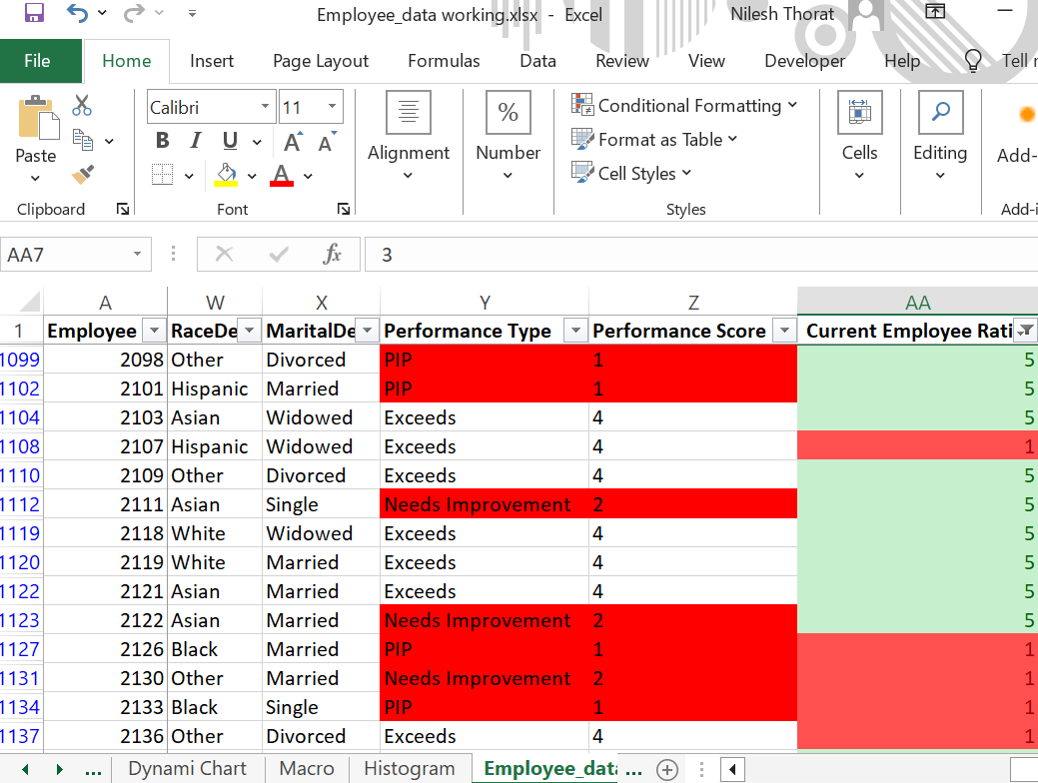
Task-15: Apply advanced conditional formatting to highlight the top 10% and bottom 10% of employees based on "Current Employee Rating."
Please find the below Screenshot of Conditional formatting by Employee Rating

Slide 17
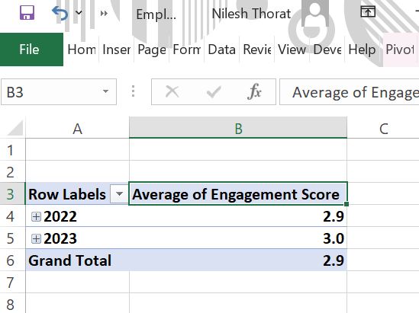
Task-16: Use a calculated field in a pivot table to determine the average "Engagement Score" per year
Please find the below Screenshot of AVG Emp Engagement Score

Slide 18
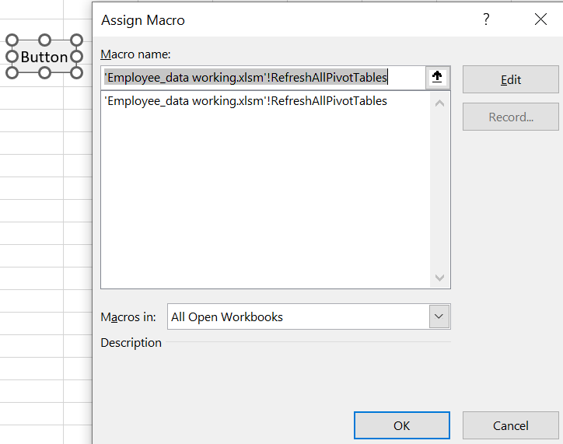
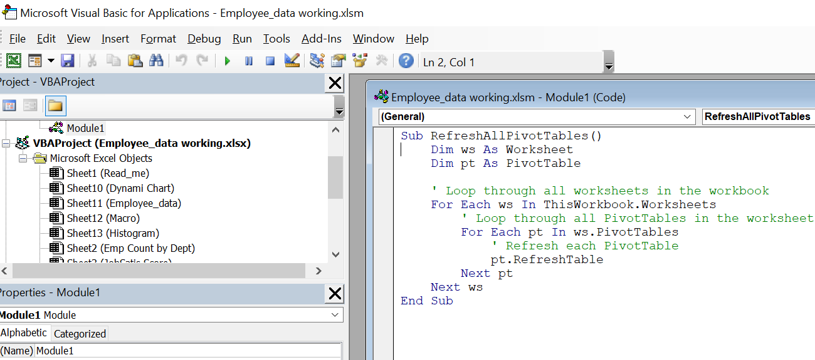
Task-17: Can you build a macro that automates the process of updating and refreshing all pivot tables in the workbook?
Please find the below Screenshots of Macro designed button for refreshing all Pivot tables

Slide 19
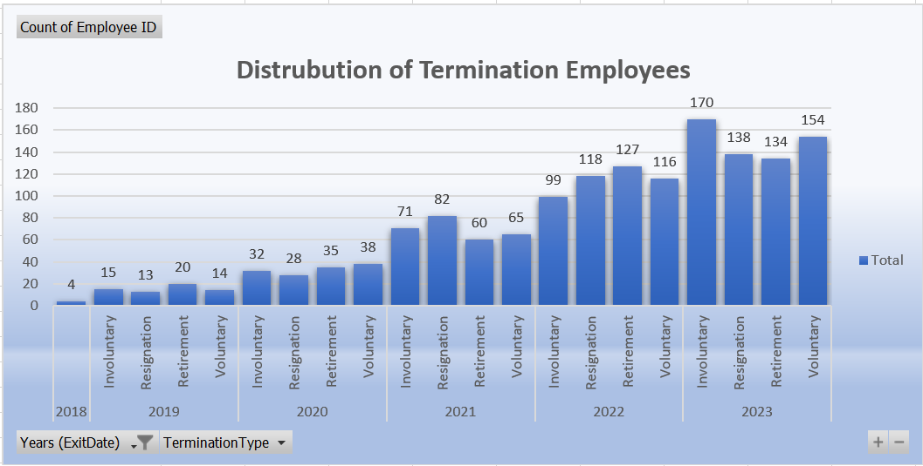
Task-18: Create a histogram to understand the distribution of "ExitDate" for terminated employees
Please find the below Screenshot of Histogram of Termination of Employees

Slide 20
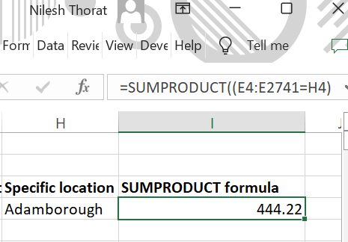
Task-19: Utilize the SUMPRODUCT function to calculate the total training cost for employees in a specific location
Please find the below Screenshot for Specific Location Taining cost

Slide 21
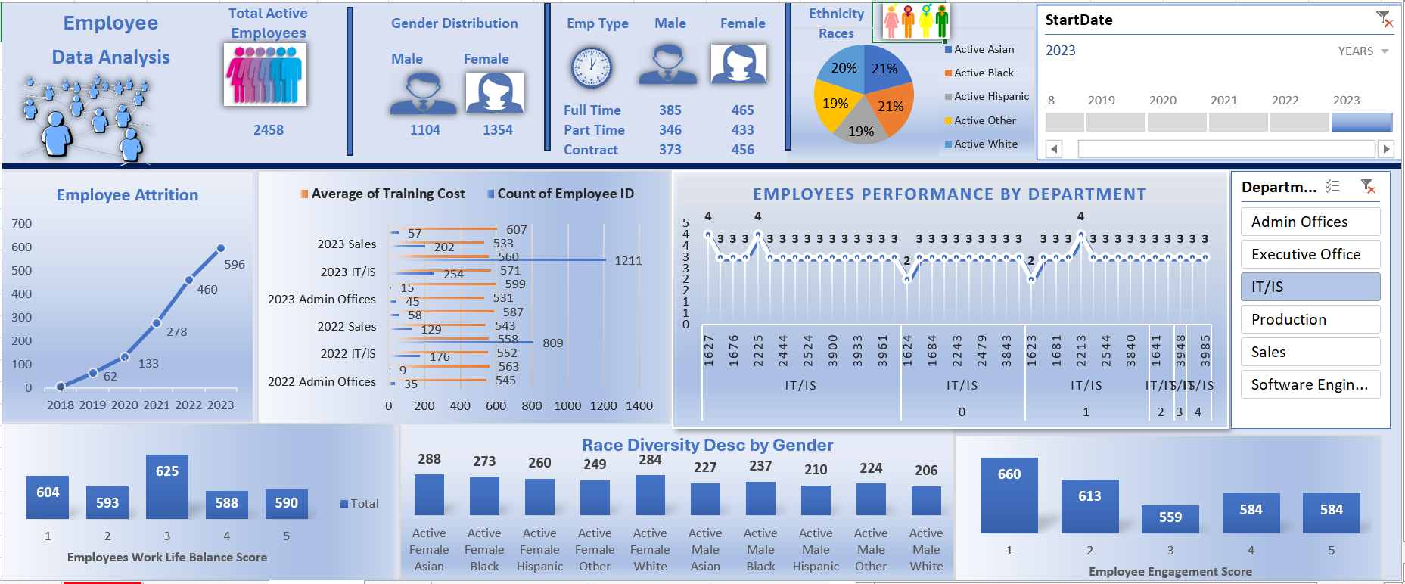
Task-20: Dashboard

Slide 22
Data Analyst : Nilesh Thorat Email : nilesh.thorat01@gmail.com Linkedin: www.linkedin.com/in/nileshthorat
Thank You

